Slide 1
Industrial Economics PPT - 6
Cost of Production
Cost Concepts: Explicit & Implicit Costs, Sunk Cost, Opportunity Cost, Accounting Cost, Economic Costs: Fixed, Variable, Total, Average, Marginal costs, Short Run Cost-Output Relationship

Slide 2
The Short Run versus the Long Run
Short Run - Period of time in which quantities of one or more production factors cannot be changed.
Fixed Input - Production factor that cannot be varied.
Long Run - Amount of time needed to make all production inputs variable.

Slide 3
Factors of Production and Cost of Production
Fixed and Variable cost of production
Fixed: not varying at each unit of output
Variable: varying at each unit of output
Cost Concepts:
Explicit & Implicit Costs, Accounting Cost, Economic Cost, Opportunity Cost, Sunk Cost,.

Slide 4
Different Concepts of Cost
Accounting cost
Actual expenses + depreciation
charges for capital equipment.
Economic cost
Cost to a firm of utilizing economic resources in production, including opportunity cost.
Opportunity cost
Cost associated with opportunities
forgone when a firm’s resources
are not put to their best
alternative use.
Explicit costs
input costs that require
an outlay of money by
the firm
Sunk cost
Expenditure that
has been made and cannot be
recovered.
Eg: Specialized machinery
No alternative use
Zero opportunity cost
Implicit costs
input costs that do not
require an outlay of
money by the firm

Slide 5
Explicit vs. Implicit Costs
Explicit Costs – are out-of-pocket costs for a firm. For example, payments for wages and salaries, rent, or materials.
Implicit Costs – are a specific type of opportunity cost: the cost of resources already owned by the firm that could have been put to some other use. For example, an entrepreneur who owns a business could use her own labour to earn income at another job.

Slide 6
Economic Costs MEASURING COST: WHICH COSTS MATTER?
Fixed Costs and Variable Costs
Total Cost (TC or C) Total economic cost of production, consisting of fixed and variable costs.
Fixed Cost (FC) Cost that does not vary with the level of output and that can be eliminated only by shutting down.
Variable Cost (VC) Cost that varies as output varies.
The only way that a firm can eliminate its fixed costs is by
shutting down.

Slide 7
Fixed Costs and Variable Costs
Shutting Down
Shutting down doesn’t necessarily mean going out of business.
By reducing the output of a factory to zero, the company could eliminate the costs of raw materials and much of the labor. The only way to eliminate fixed costs would be to close the doors, turn off the electricity, and perhaps even sell off or scrap the machinery.
Fixed or Variable?
How do we know which costs are fixed and which are variable?
Over a very short time horizon—say, a few months—most costs are fixed. Over such a short period, a firm is usually obligated to pay for contracted shipments of materials.
Over a very long time horizon—say, ten years—nearly all costs are variable. Workers and managers can be laid off (or employment can be reduced by attrition), and much of the machinery can be sold off or replaced as it becomes obsolete and is scrapped.

Slide 8
MEASURING COST: WHICH COSTS MATTER?
Marginal and Average Cost
Average Total Cost (ATC)
Average Total Cost (ATC) Firm’s total cost divided by its level of output.
Average Fixed Cost (AFC)
Fixed cost divided by the level of output.
Average Variable Cost (AVC) Variable cost divided by the level of output.

Slide 9
MEASURING COST: WHICH COSTS MATTER?
Marginal and Average Cost
Marginal Cost (MC)
Marginal Cost (MC) Increase in cost resulting from the production of one extra unit of output.
Because fixed cost does not change as the firm’s level of output changes, marginal cost is equal to the increase in variable cost or the increase in total cost that results from an extra unit of output.
We can therefore write marginal cost as

Slide 10

Formulas:
Marginal cost (MC)
Increase in cost resulting from the
production of one extra unit of output.
Average total cost (ATC)
Firm’s total cost divided by its level of output.
TC/q
Average fixed cost (AFC)
Fixed cost divided by the level of output.
FC/q
Average variable cost (AVC)
Variable cost divided by the level of output.
VC/q

Slide 11
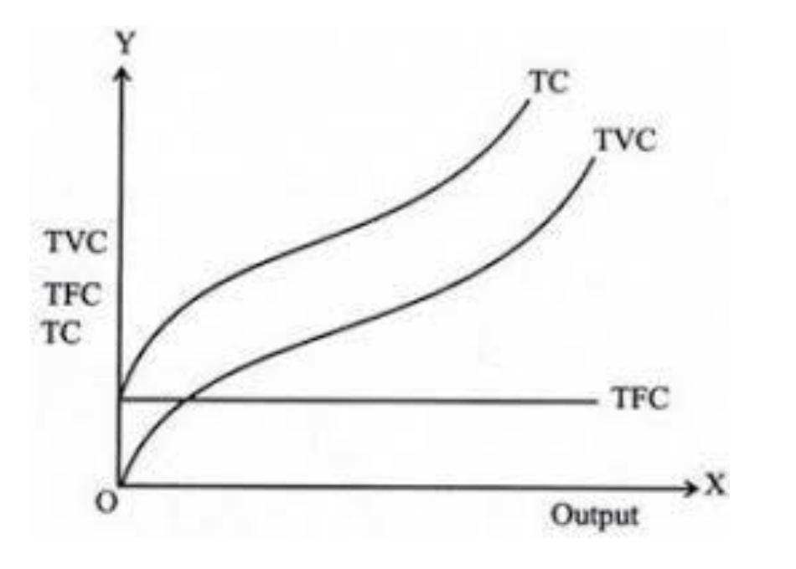
Shape of the Cost Curves

Slide 12
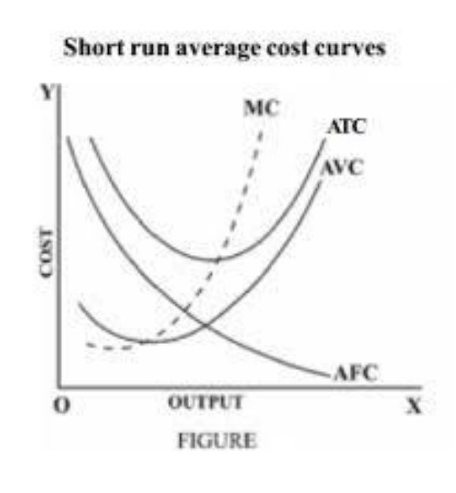
Shape of the Cost Curves

Slide 13
The Average - Marginal Relationship
The ATC curve shows the average total cost of production.
Because average total cost is the sum of average variable cost and average fixed cost and the AFC curve declines everywhere, the vertical distance between the ATC and AVC curves decreases as output increases.
The AVC cost curve reaches its minimum point at a lower output than the ATC curve.
This follows because MC = AVC at its minimum point and MC = ATC at its minimum point.
Because ATC is always greater than AVC and the marginal cost curve MC is rising, the minimum point of the ATC curve must lie above and to the right of the minimum point of the AVC curve.

Slide 14
A Production Process With Labour
Labour | Production | Marginal Productivity | Cost | Marginal Cost
1 | 10 | 10 | 100 | 10
2 | 30 | 20 | 200 | 5 = (200100)/ (30-10)
3 | 60 | 30 | 300 | 3.33
4 | 80 | 20 | 400 | 5
5 | 95 | 15 | 500 | 6.67
6 | 108 | 13 | 600 | 7.70
7 | 112 | 4 | 700 | 25
Wage = 100 Rupees per Labour

Slide 15
Marginal Product of Labour and Marginal Cost
35
30
25
20
Marginal Product of Labour
Marginal Cost
15
10
5
0
1
2
3
4
5
6
7

Slide 16

Marginal Cost Curve
The change in variable cost is the per-unit cost of the extra labor w times the amount of extra labor needed to produce the extra output ΔL. Because ΔVC = wΔL, it follows that
The extra labor needed to obtain an extra unit of output is ΔL/Δq = 1/MP_{L}. As a result,
(7.1)
Diminishing Marginal Returns and Marginal Cost
Diminishing marginal returns means that the marginal product of labor declines as the quantity of labor employed increases.
As a result, when there are diminishing marginal returns, marginal cost will increase as output increases.

Slide 17
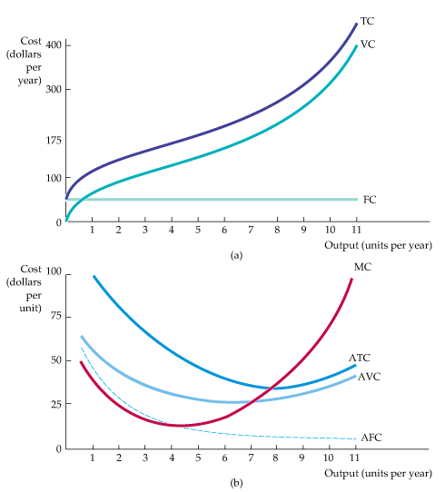
COST IN THE SHORT RUN
The Shapes of the Cost Curves
Figure 7.1
Cost Curves for a Firm
In (a) total cost TC is the vertical sum of fixed cost FC and variable cost VC.
In (b) average total cost ATC is the sum of average variable cost AVC and average fixed cost AFC.
Marginal cost MC crosses the average variable cost and average total cost curves at their minimum points.

Slide 18
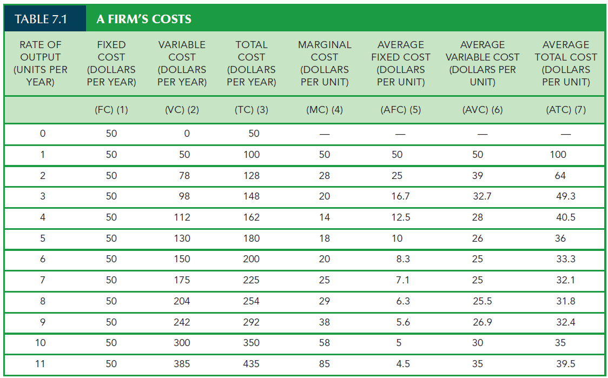

Slide 19
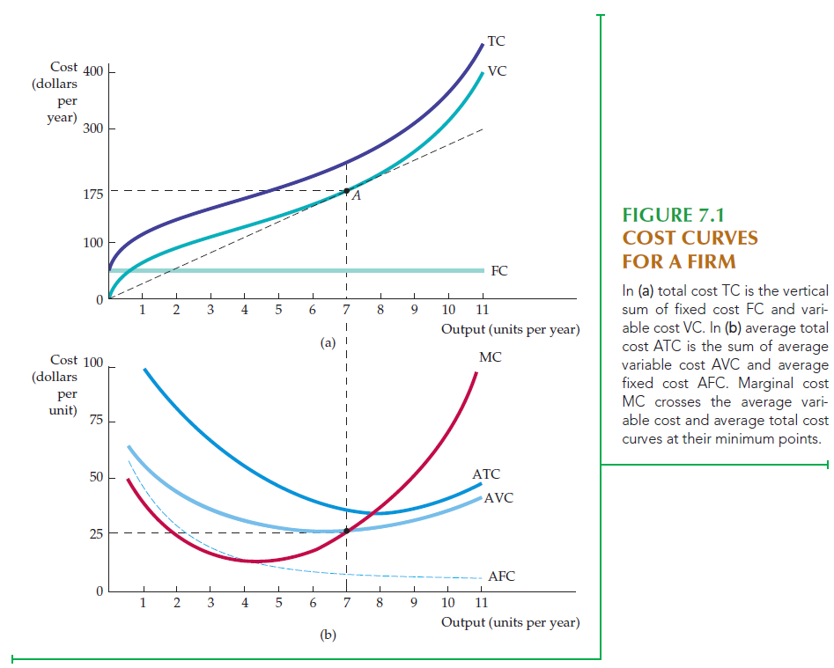

Slide 20
MEASURING COST: WHICH COSTS MATTER?
Economic Cost versus Accounting Cost
Accounting Cost Actual expenses plus depreciation charges for capital equipment.
Economic Cost Cost to a firm of utilizing economic resources in production, including opportunity cost.
Opportunity Cost
Opportunity Cost Cost associated with opportunities that are forgone when a firm’s resources are not put to their best alternative use.

Slide 21
MEASURING COST: WHICH COSTS MATTER?
Sunk Cost Expenditure that has been made and cannot be recovered.
Because a sunk cost cannot be recovered, it should not
influence the firm’s decisions.
For example, consider the purchase of specialized equipment for a plant. Suppose the equipment can be used to do only what it was originally designed for and cannot be converted for alternative use. The expenditure on this equipment is a sunk cost.
Because it has no alternative use, its opportunity cost is zero.
Thus it should not be included as part of the firm’s economic costs.

Slide 22
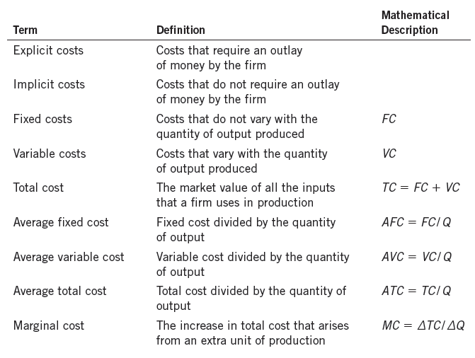

Slide 23
The Structure of Costs in the Short Run
The cost of producing a firm’s output depends on how much labor and physical capital the firm uses.
A list of the costs involved in producing cars will look very different from the costs involved in producing computer software or haircuts or fast-food meals. However, the cost structure of all firms can be broken down into some common underlying patterns.
When a firm looks at its total cost of production in the short run, a useful starting point is to divide total cost into two categories: fixed costs that cannot be changed in the short run and variable costs that can be changed in the short run.
Fixed and Variable Costs
Fixed costs are expenditures that do not change based on the level of production, at least not in the short term. Whether you produce a lot or a little, the fixed costs are the same.
One example is the rent on a factory or a retail space. Once you sign the lease, the rent is the same regardless of how much you produce, at least until the lease runs out.

Slide 24
Fixed costs can take many other forms. For example, the cost of machinery or equipment to produce the product, research and development costs to develop new products, even advertising to popularize a brand name are all fixed costs.
The level of fixed costs varies according to the specific line of business. Manufacturing computer chips, for instance, requires an expensive factory, but a local moving and hauling business can get by with almost no fixed costs at all if it rents trucks by the day when needed.
Variable costs, on the other hand, are incurred in the act of producing—the more you produce, the greater the variable cost.
Labor is treated as a variable cost since producing a greater quantity of a good or service typically requires more workers or more work hours. Variable costs also include raw materials.

Slide 25
Short Run Cost: An Example
As a concrete example of fixed and variable costs, we'll imagine a barber shop called The Clip Joint.
The table below shows the data for the barber shop's output and costs.
The fixed costs of operating the barber shop, including the space and equipment, are $160 per day.
The variable costs are the costs of hiring barbers, which in our example are $80 per barber each day.
The first two columns of the table show the quantity of haircuts the barbershop can produce as it hires additional barbers. The third column shows the fixed costs, which do not change regardless of the level of production. The fourth column shows the variable costs at each level of output. These numbers are calculated by taking the amount of labor hired and multiplying by the wage. For example, two barbers cost 2 × $80 = $160.
Adding together the fixed costs in the third column and the variable costs in the fourth column produces the total costs in the fifth column. So, for example, with two barbers the total cost is $160 + $160 = $320.

Slide 26
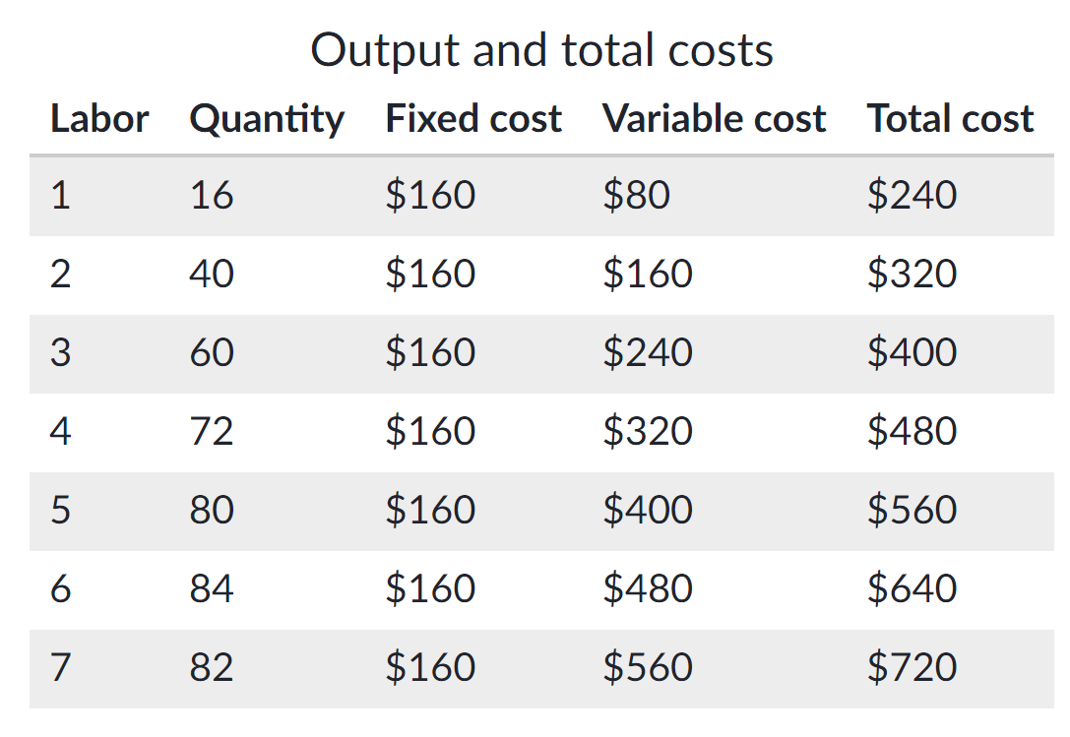

Slide 27
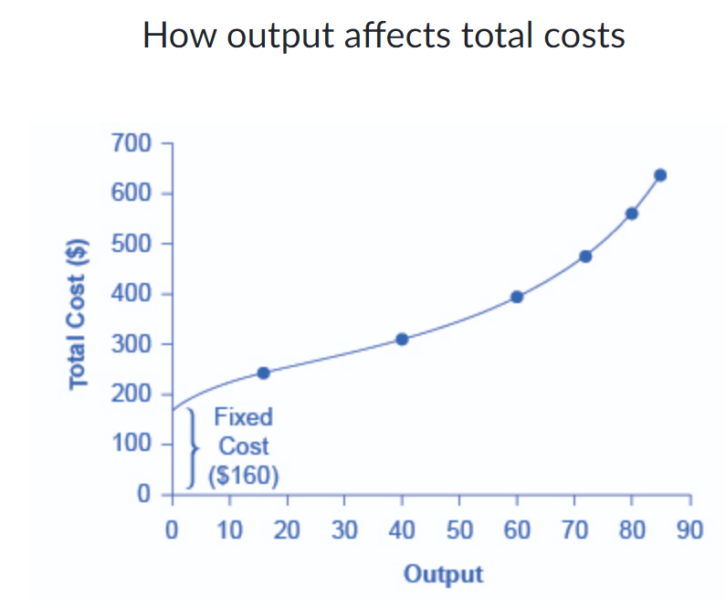
Next, we'll use the graph below to examine the relationship between the quantity of output being produced and the cost of producing that output.
Fixed costs are always shown as the vertical intercept of the total cost curve; they are the costs incurred when output is zero, so there are no variable costs.

Slide 28
You can see in the graph that once production starts, total costs and variable costs rise. While variable costs may initially increase at a decreasing rate, at some point they begin increasing at an increasing rate. This phenomenon is caused by diminishing marginal returns.
As the number of barbers increases from zero to one in the table, output increases from zero to 16 for a marginal gain of 16.
As the number rises from one to two barbers, output increases from 16 to 40, a marginal gain of 24.
From that point on, though, the marginal gain in output diminishes as each additional barber is added.
For example, as the number of barbers rises from two to three, the marginal output gain is only 20; and as the number rises from three to four, the marginal gain is only 12.
To understand the reason behind this pattern, consider that a one-man barber shop is a very busy operation. The single barber needs to do everything—say hello to people entering, answer the phone, cut hair, sweep up, and run the cash register.
A second barber reduces the level of disruption from jumping back and forth between these tasks and allows a greater division of labor and specialization. The result can be greater increasing marginal returns.

Slide 29
However, as other barbers are added, the advantage of each additional barber is less since the specialization of labor can only go so far.
The addition of a sixth or seventh or eighth barber just to greet people at the door will have less impact than the second one did.
This is the pattern of diminishing marginal returns. As a result, the total costs of production will begin to rise more rapidly as output increases.
At some point, you may even see negative returns as the additional barbers begin bumping elbows and getting in each other’s way. In this case, the addition of still more barbers would actually cause output to decrease, as shown in the last row of the table where quantity has decreased from 84 to 82 despite the addition of another barber.
This pattern of diminishing marginal returns is common in production. It occurs because, at a given level of fixed costs, each additional input contributes less and less to overall production.

Slide 30
Key Points
Looked at from a short-run perspective, a firm’s total costs can be divided into fixed costs, which a firm must incur before producing any output, and variable costs, which the firm incurs in the act of producing.
Fixed costs are sunk costs—because they are in the past and cannot be altered, they should play no role in economic decisions about future production or pricing.
Variable costs typically show diminishing marginal returns, so the marginal cost of producing higher levels of output rises.
Total cost is the sum of fixed and variable costs of production.

Slide 31
Sample Question:
The short-run cost function of a company is given by the equation TC = 200 + 55q, where TC is the total cost and q is the total quantity of output, both measured in thousands.
What is the company’s fixed cost?
If the company produced 100,000 units of goods, what would be its average variable cost?
What would be its marginal cost of production?
What would be its average fixed cost?

